Slide 1

College website Project
Here we go

Slide 2
Table of Contents
01
02
03
04
05
06
Our Team
Requirements
About the Project
members of team
functional website
format the layout of Web pages.
Project Goals
Project Stages
process of building the web
Sneak Peek
Steps for building
Glimpse of website

Slide 3

Our Team
Vaibhav Sharma
10621563
JavaScript,CSS
Yogeshwar Vashist
10621619
HTML,CSS
Sachin Kumar
10621452
Documentation

Slide 4
Our Website
Website you 24/7 :No employee will do that

Slide 5

02
About the Project
Make it easier for Student to
Know events Happening in college in
more Efficient and Attractive Manner.

Slide 6


Our Set of Ideas
Communicate knowledge to the reader
Make the reader more likely to act
based on this knowledge

Slide 7
What We Are Working On
Contains hundreds of mini-sites designed
with information.
how they
connect to each other and to the site as a
whole.
Reflects and describes the visitor’s needs and viewpoint

Slide 8

About the Project
aim of this project is to develop an online website which covers all the details of college i.e.; Event details, Students details, also reduce the cumbersome paperwork, manual labor as well as communication cost.

Slide 9
—Someone Famous
“Your website is the window of your project. Keep it fresh, keep it exciting.”

Slide 10

Now
design, publish and maintain a website for our college which consists of all the information regarding the college like Basic information about website Short hand notices

Slide 11
Major Requirements
HTML
CSS
Javascript
used to format the layout of Web pages. They can be used to define way of writing or style, size of various table
to add various Web function, validations, detections, a creation of cookies and so on.
in reality , a spinal cord of any website. Any website can’t be structured without the knowledge of HTML.

Slide 12
Project Goals
GOAL 1
GOAL 2
GOAL 3
Planning with our guider will help achieve goals, and allows for efficient use of time and development resources
Team discussion will help us translate the guider requirements into a fool-proof website project plan.
Design and development is the process of building the web according to its design

Slide 13
Awesome Words
Because key words are great for
catching your audience’s attention

Slide 14
Project Stages
Planning
Implementation/
Coding
TESTING
Stage 1
Stage 2
Stage 3

Slide 15
Timeline
Team discussion
Final/ System testing
01
02
03
04
Guider collaboration
Building
/ coding

Slide 16
Limitations
The website lacks a secure payment gateway which makes it impossible to conduct online payments for admission fees or any other form of payments.
The website cannot accurately track the user's journey throughout the entire site and provide personalized experience accordingly.
The website does not feature a comprehensive online library which can be used by the students, faculty, and staff.
There is no single platform on which all communication between the college faculty, staff, and students occurs in an organized manner.
It is hard to create an interactive dashboard where anyone can visualize relevant college data from different sources like courses offered, classes taken, fee structure etc., in easy understandable way unavailable at this moment.
0

Slide 17

Future
All the record stores in database. The proposed software will also reduce the cumbersome paperwork, manual labor as well as communication cost.

Slide 18
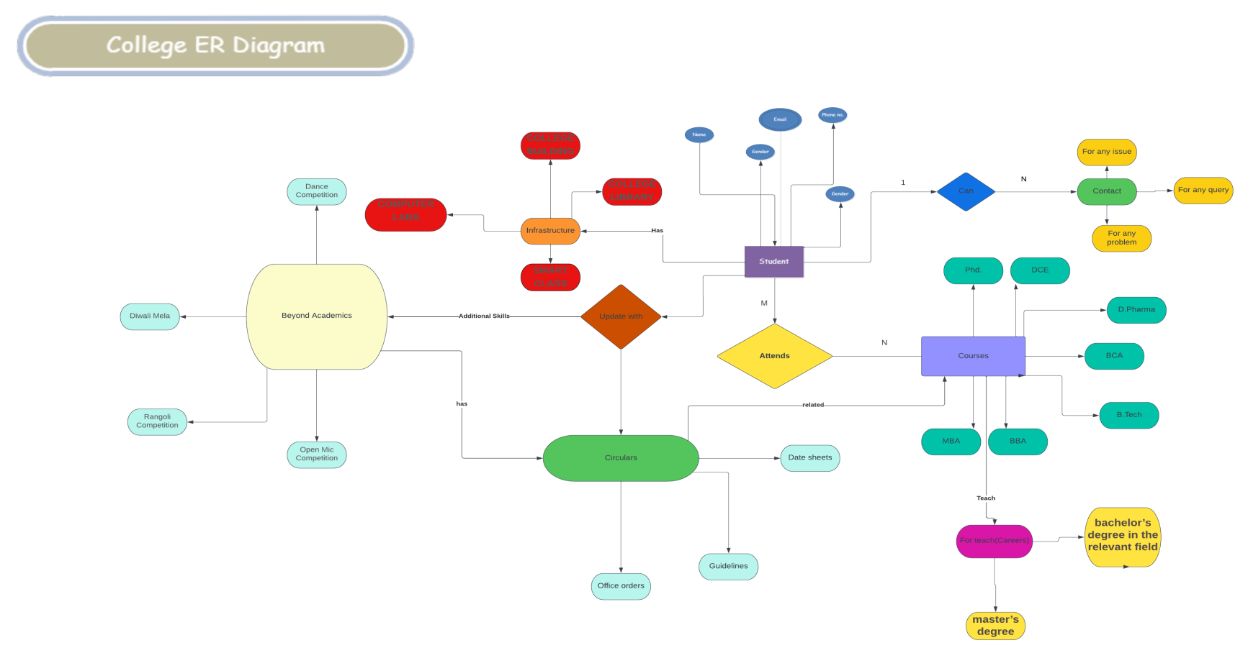
Er Diagram

Slide 19
This Is an Infographic
Parents
Phone Number
Self
Student
Course
Address
State
Semester
Year
City
Roll No.
Name

Slide 20

A Picture Is Worth
a Thousand Words

Slide 21
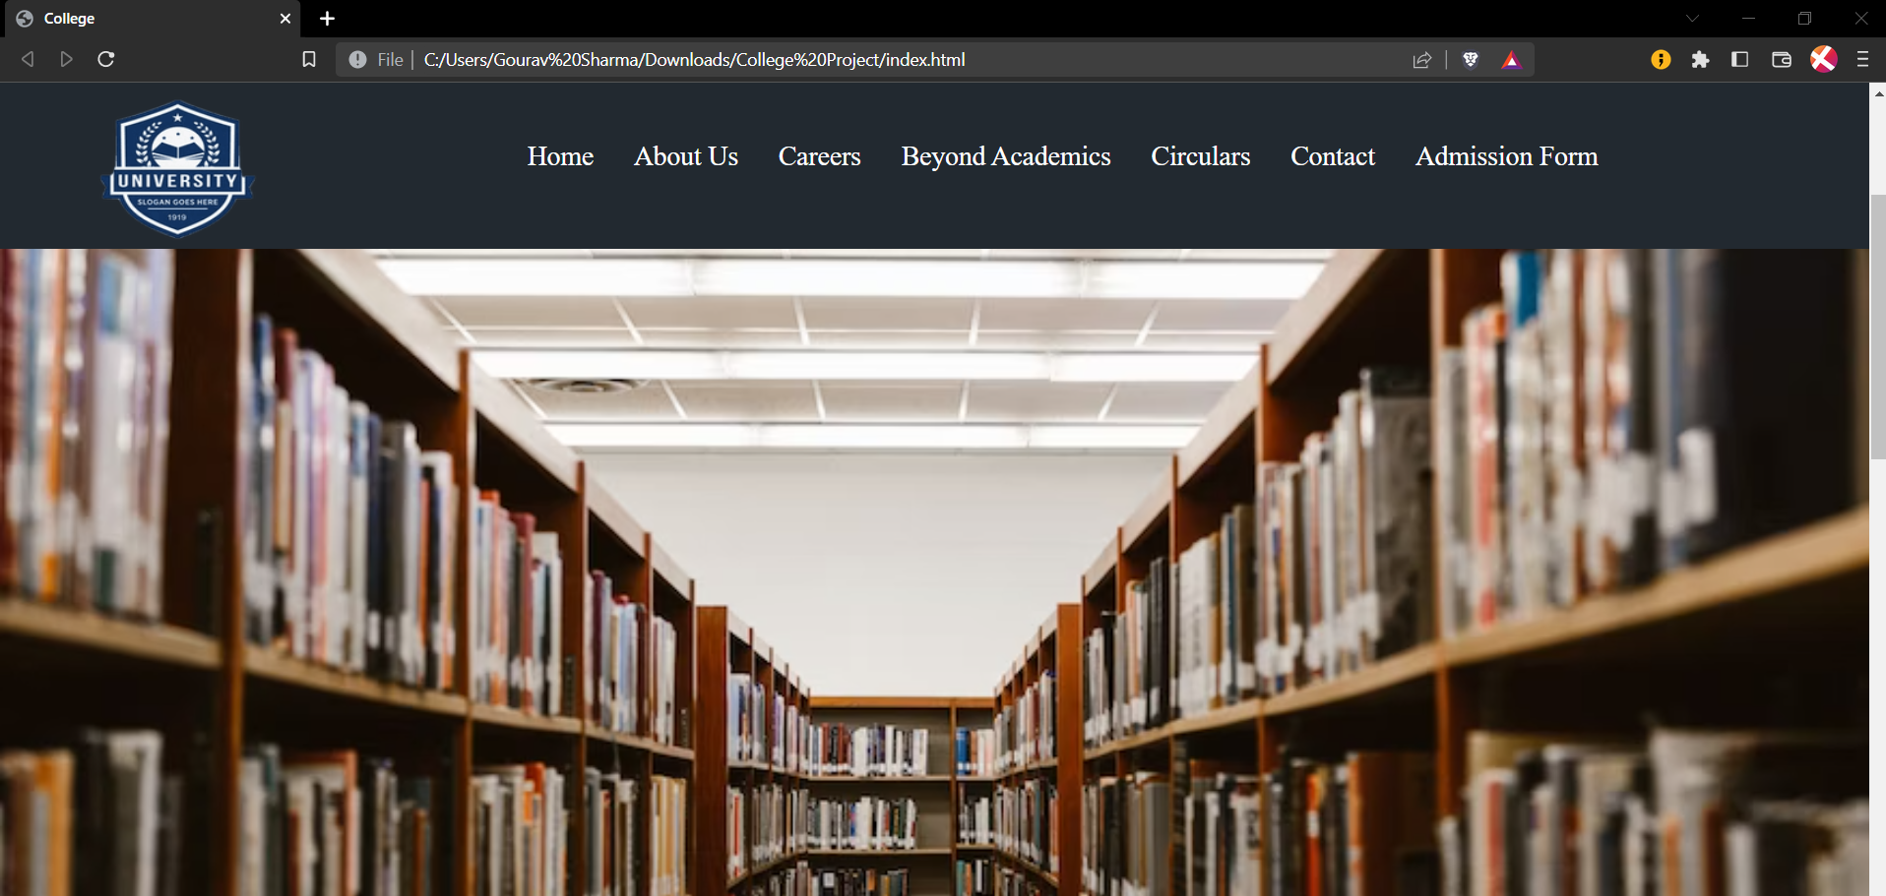
Sneak Peek
Ensure the public website executes the
web presence goals and objectives of
College leadership

Slide 22
References
Videos:
Full CSS Tutorial By Code with Harry
Full HTML Tutorial By Code with Harry
Full Java script Tutorial By Code with Harry
W3 Schools
Geeks for Geeks
Video/Website Links:
https://www.codewithharry.com/videos/web-development-in-hindi-103/
https://www.ustube.com/watch?v=hKB-YGF14SY.
https://www.google.com/search?q=quotes+on+website&sxsrf=ALiCzsZnF4qRlNNXCiO2LNSOzqwEb4Ehkw:1672938548414&source=lnms&tbm=isch&sa=X&ved=2ahUKEwjF3KLf9bD8AhXLxXMBHY6oD4oQ_AUoAXoECAEQAw&biw=1536&bih=767&dpr=1.25#imgrc=hAc9HeDSUz8L9MMan and woman with papers

Slide 23

Thanks!
Do you have any questions?
youremail@freepik.com
+91 7836971626yourcompany.com

